Slide 1

Data Science & SPACEX
By: Michal Uhrinek
Date: 15.11.2022

Slide 2

Executive Summary
Introduction
Methodology
Results
Visualization – Charts
Dashboard
Discussion
Findings & Implications
Conclusion
Appendix

Slide 3
EXECUTIVE SUMMARY
Summary of Methodology
Data Collection using API technology
Data Collection with web scraping
Data Wrangling
Exploratory Data Analysis with SQL
Exploratory Data Analysis with Data Visualisation
Interactive Visual Analytics with Folium
Machine Learning Prediction

Slide 4
INTRODUCTION
In this capstone I will take the role of a data scientist working for a new rocket company
determine the price of each launch of SPACE X
Do this by gathering information about Space X and creating dashboard for the team.
And also determine if Space X will reuse the first stage. (use same rockets, same materials..)
Instead of using rocket science to determine if the first stage will land successfully, you will train a machine learning model and use public information to predict if Space X will reuse the first stage.

Slide 5
SECTION 1.
METHODOLOGY

Slide 6
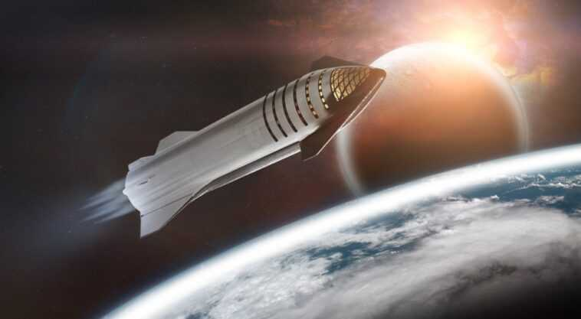
METHODOLOGY
EXECUTIVE SUMMARY:
Data collection - methodology:
Get request to the Space X API and web scraping from Wikipedia
Perform data wrangling
Clean the data
Perform exploratory data analysis (EDA), using visualization and SQL
Perform interactive visual analytics using Folium and Plotly Dash
Perform predictive analysis using classification models
Creating machine learning model.

Slide 7
Data collection
The Data Sets are collected by:
Space X API request
Web Scrapping
Phase 1
Enter the URL of the page you want to analyze for this project
Phase 2
Request and parse the Space X launch data using GET request
Phase 3
Phase 4
Now use the API again to get information about launches using IDs given for each launch
Decode the response content as a JSON file and turn it into a Pandas Dataframe
Phase 5
Filter the data frame to only include Falcon 9 launches and replace null values and get required output (clean data in dataframe)

Slide 8
Data collection – SPACEX API
Data collection by web-scrapping process is give a flow chart as you can see. For completed Notebook link given below.
Git Hub URL link:
https://github.com/mikediego/Mike/blob/62cc4fab04f9b3e8d15eae6e86de15b016000dae/SPACEX-DATACOLLECTION-api.ipynb
Falcon9 Launch wiki page from URL
Create a Beautiful Soup object from the HMTL
Convert dictionary into a CSV dataset.
Extract all column and names from the HTML table
Create an empty dictionary with keys from the column names.
Fill up dictionary with launch records extracted from the table rows.

Slide 9
Data wrangling
Data wrangling process is give a flow chart as you can see. For completed Notebook link given below.
Git Hub URL link:
https://github.com/mikediego/Mike/blob/62cc4fab04f9b3e8d15eae6e86de15b016000dae/Data%20wrangling%20-%20Complete%20the%20EDA.ipynb
Calculate the number of launches on each site.
Calculate the number of occurrences on each orbit.
Calculate the number and occurrence of mission outcome per orbit type.
Create a landing outcome label from Outcome column

Slide 10
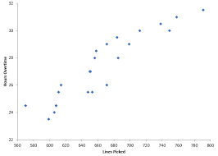
EDA with data visualization
Types of charts used:
Scatter plot – Flight Number vs Payload Mass , Flight Number vs Launch Site, Payload and Launch Sites, Flight Number and Orbit Type, Payload and Orbit type
Bar chart – Success rate of each orbit
Line plot – success rate and date
EDA with data visualization complete notebook link is below:
GITHUBLINK: https://github.com/mikediego/Mike/blob/62cc4fab04f9b3e8d15eae6e86de15b016000dae/Exploratory%20Data%20Analysis%20using%20AIDA.ipynb

Slide 11
EDA WITH SQL
Summary of SQL queries that were used:
Display the names of the unique launch sites in the space mission
Display 5records where launch sites begin with string: ‘cca’
Display average payload mass carried by boosters launched by NASA (CRS)
Display average payload mass carried by booster version F9, v1.1
List the date when the first successful landing outcome in the ground pas was achieved
List the names of boosters which have success in drone ship and have payload mass greater than 4000 but less than 6000
List the total number of successful and failure mission outcomes
List the names of the booster version which have carried the maximum payload mass. Use a subquery
List the failed landing outcomes in drone ship, their booster version, and launch site names for in year 2015
Rank the count of a landing outcomes (such as failure (drone ship) or success (ground pad)) between the date 2010-06-04
and 2017-03-20, in description order:
GITHUB LINK:

Slide 12
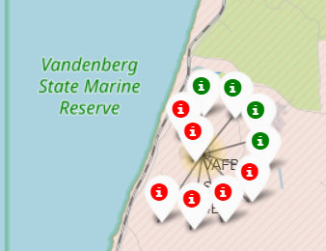
BUILD AN INTERACTIVE MAP WITH FOLIUM
Folium markers were used to show SPACE X launch sites and their nearest important landmark lines like: railway, highway, cities and coastline.
RED = represent rocket launch failures
GREEN = successful rocket launch
GITHUB LINK:
https://github.com/mikediego/Mike/blob/62cc4fab04f9b3e8d15eae6e86de15b016000dae/SPACEX_SQL_LOADDATA.ipynb

Slide 13

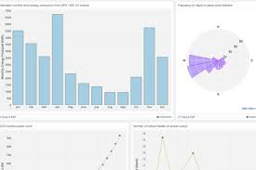
Build a dashboard with plotly dash
Pie chart and scatter charts were used to visualize the launch records of SPACE X
These charts displayed the rocket launch success rate per launch site. We are able to get an understanding of the factors that may have been influencing the success rate at each site. Such as payload mass, booster version.
Succesful launches were represented by 1 while failures were represented by 0.

Slide 14
PREDICTIVE ANALYSIS
Scikit-learn is a Machine-learning library that was used for predictive analysis. The following took place:
Create a machine model pipeline to predict if the first stage will land given the data.
GITHUB LINK: https://github.com/mikediego/Mike/blob/62cc4fab04f9b3e8d15eae6e86de15b016000dae/SpaceX_Dashboard.py
Create a columns for the class
Standardize the data
Split data into train and test data
Create Grid SearchCV object and fit different ML object
Calculate the accuracy on the test data
Compare the prediction with the real labels.
Choose the best ML method

Slide 15
Results
The exploratory data analysis has shown us that successful landing outcomes are somewhat correlated with flight number. It was also apparent that successful landing outcomes have had a significant increase since the year 2015.
All launch sites are located near the coast line. Maybe this make it easier to launch it near the water.
Sites are also located near highways and railways. This may facilitate, transportation of equipment and research materials.
The machine learning were able to predict landing success of rockets with an accuracy score of 83,33% check the score

Slide 16
SECTION 2
INSIGHTS DRAWN FROM EDA

Slide 17
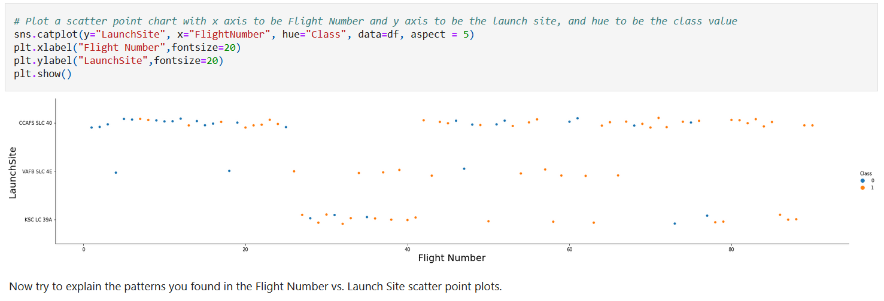
FLIGHT NUMBER VS. LAUNCH SITE
It shows that there were more successful landings as the flight numbers increased. Launch site CCAFS SLC40 had the most number of landings.

Slide 18
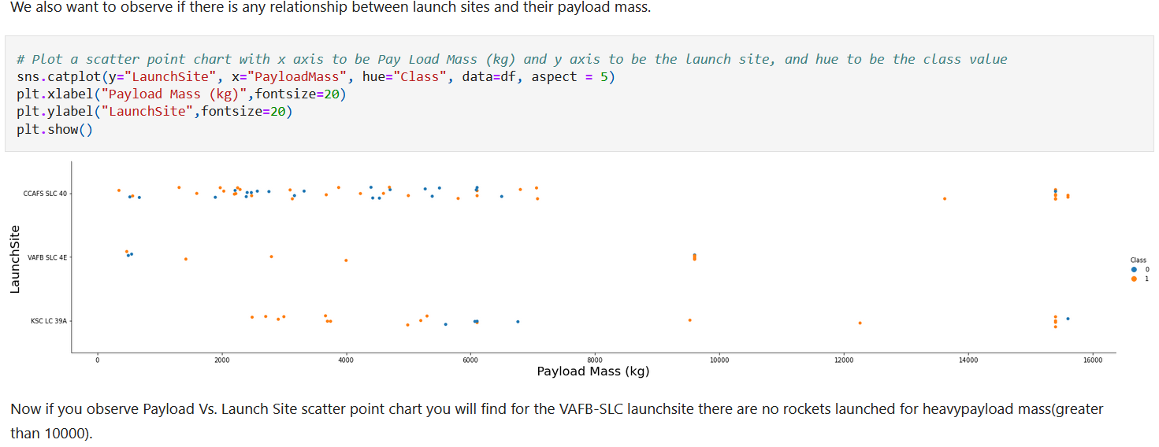
Payload mass vs. launch site
Insert graf from machine learning

Slide 19
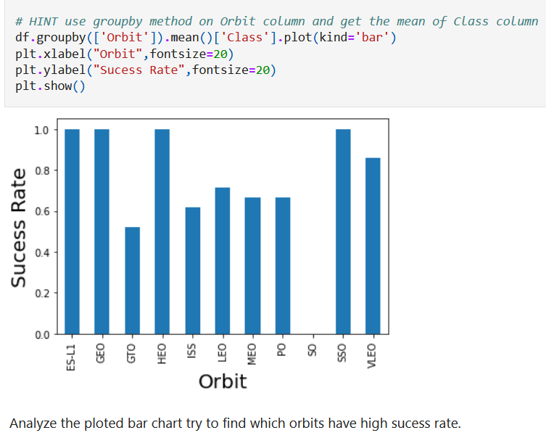
Success rate vs. orbit type
The highest success rate orbits are:
ES-L1
GEO
SSO
HEO

Slide 20
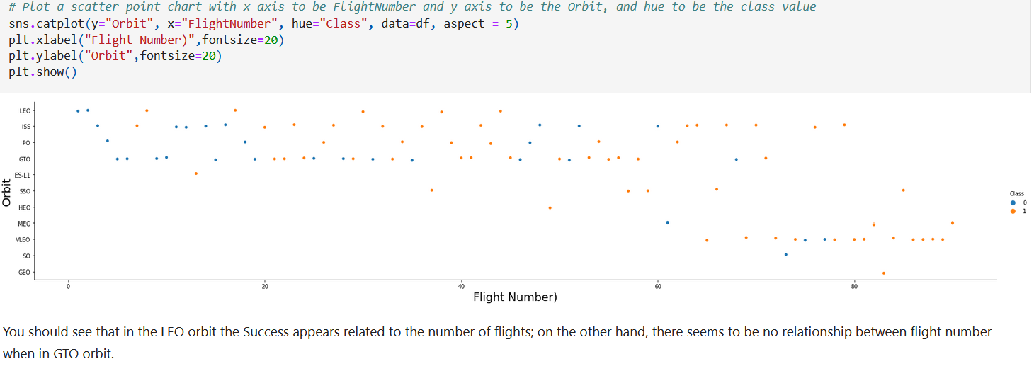
Flight number vs. orbit type

Slide 21
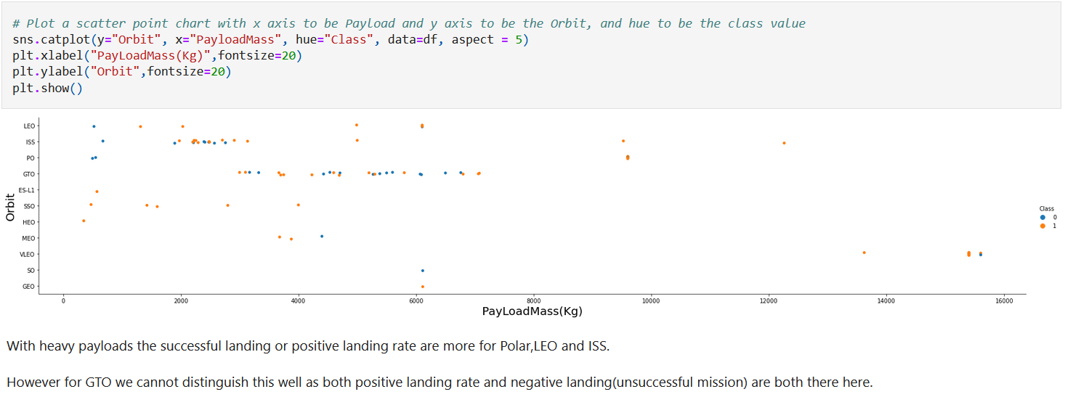
Payload mass vs. orbit type

Slide 22
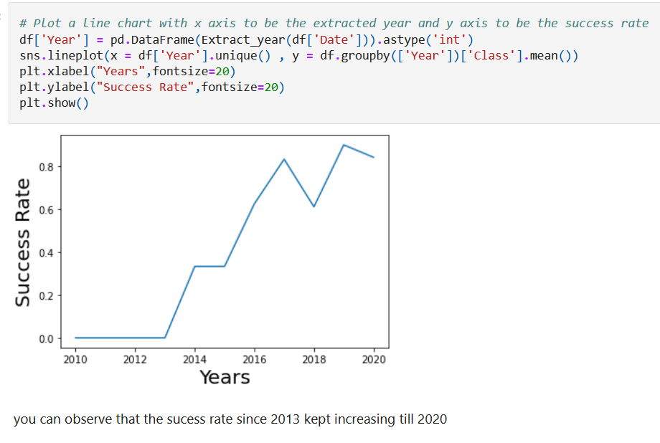
Launch success early trend
Graph from machine learning

Slide 23
All launch site names
CCAFS LC-40
CCAFS SLC-40
KSC LC-39A
VAFB SLC-4E

Slide 24
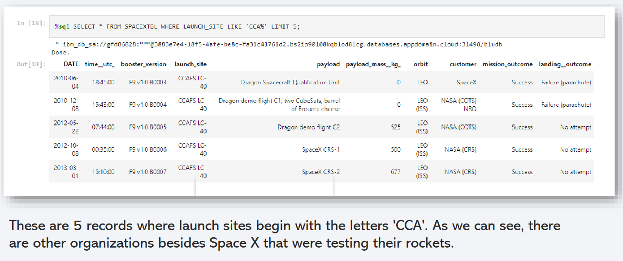
Launch Site Names Beginning with 'CCA'

Slide 25
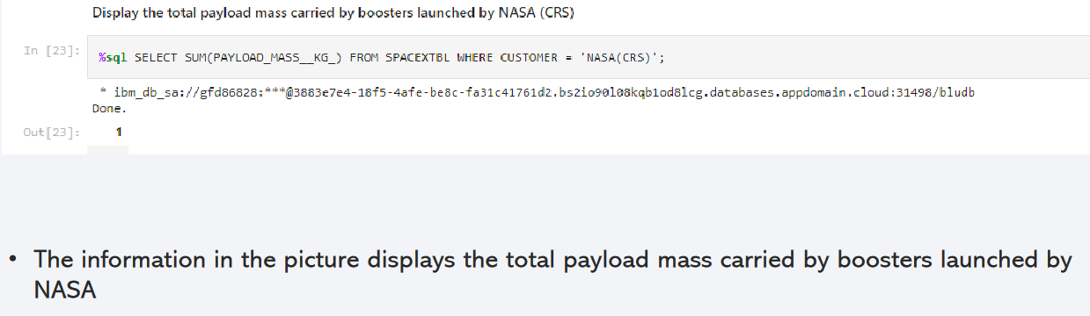
Total Payload Mass

Slide 26
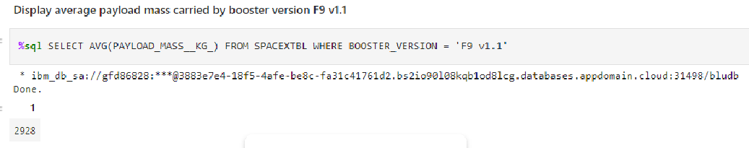
Average Payload Mass by F9 v1.1
The average payload mass carried by F9 v1.1 was 2928 kg
First Successful Ground Landing Date
• First Successful Ground Landing Date was in Dec 22, 2015

Slide 27
Successful Drone Ship Landing with Payload between 4000 and 6000
It appears that there are only 4 Boosters with a payload mass between 4000 and 6000 which are:
F9 FT B1022
• F9 FT B1026
F9 FT B1031.2
F9 FT B1021.2

Slide 28
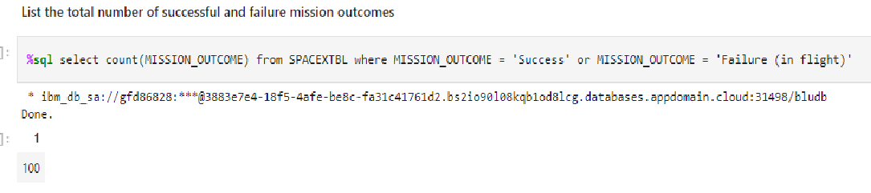
Total Number of Successful and Failure Mission Outcomes
The Above picture show the total number of successful and failure mission outcomes

Slide 29
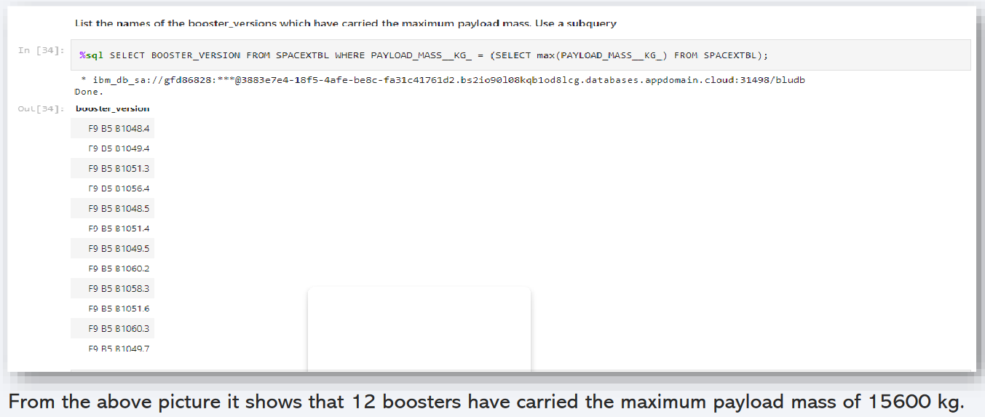
Boosters That Carried the Maximum Payload Mass

Slide 30
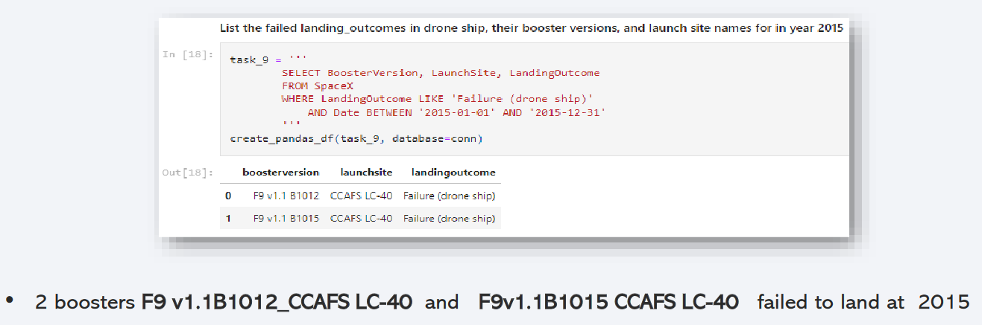
2015 Launch Records - Failed Landing Outcomes

Slide 31
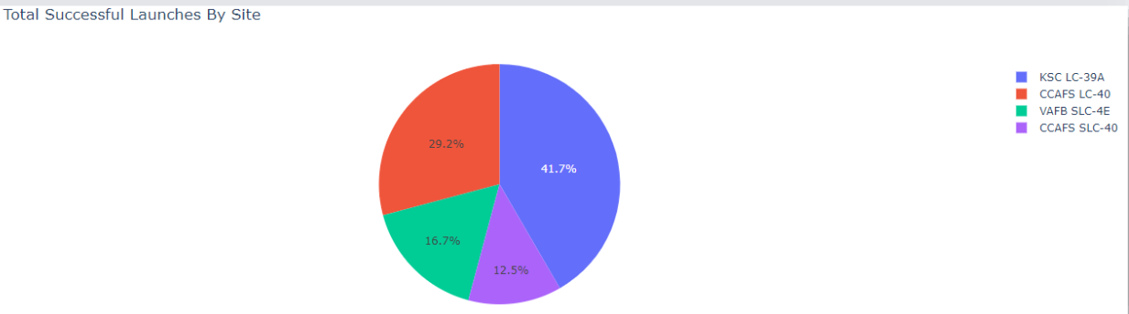
TOTAL SUCCESSFUL LAUNCHES BY SITE

Slide 32
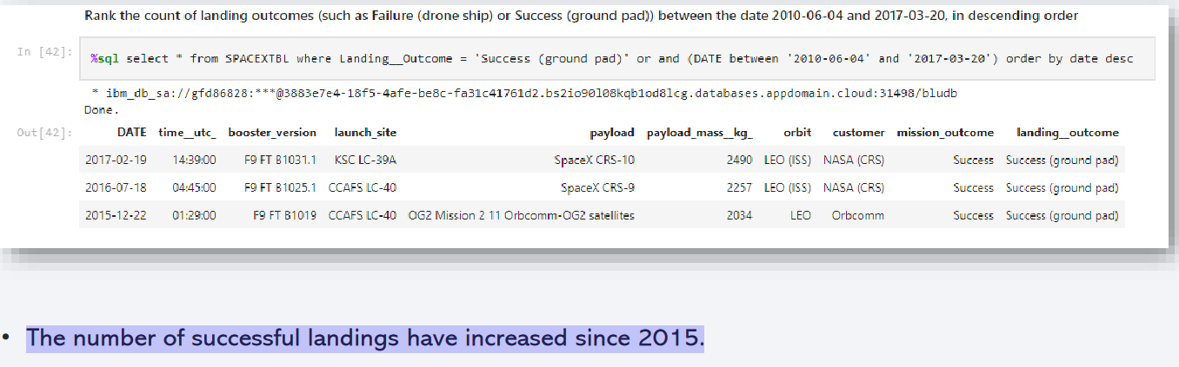
Rank Landing Outcomes Between 2010-06-04 and 2017-03-20

Slide 33
Section 3
BUILD AN INTERACTIVE MAP WITH FOLIUM

Slide 34
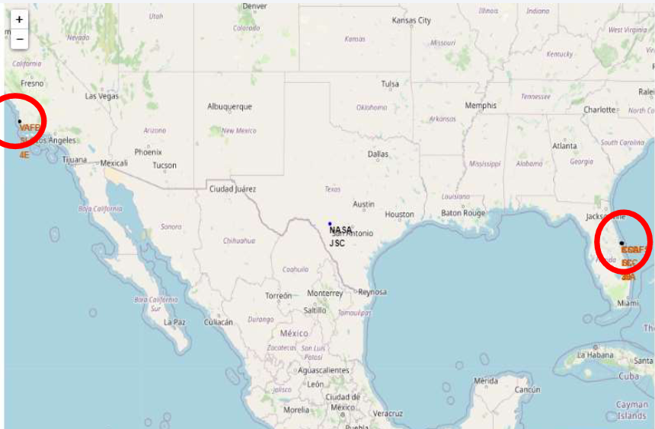
Section 3
BUILD AN INTERACTIVE MAP WITH FOLIUM
Launch Site Locations
All launch sites are in very close proximity to the coast and they are also a couple thousand kilometers away from the equator line.
GITHUB LINK: https://github.com/mikediego/Mike/blob/62cc4fab04f9b3e8d15eae6e86de15b016000dae/SpaceX_visualisation_folium.ipynb

Slide 35
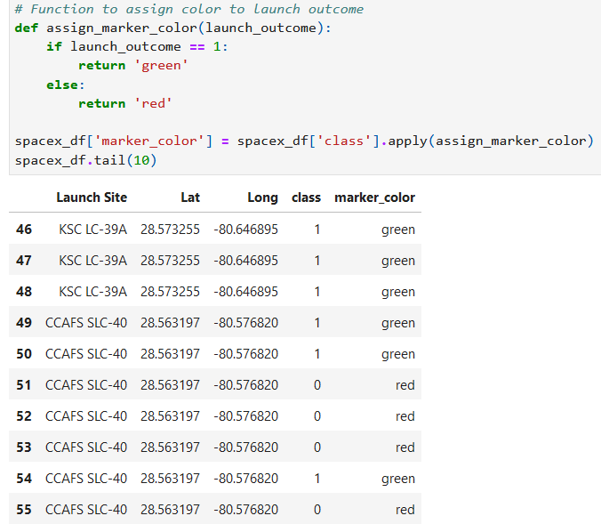
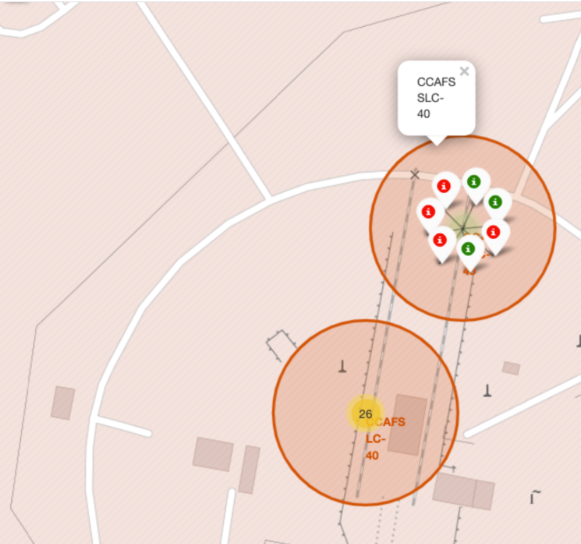
The successful launches are represented by a green marker while the red marker represents failed rocket launches.
Success Rate of Rocket Launches

Slide 36
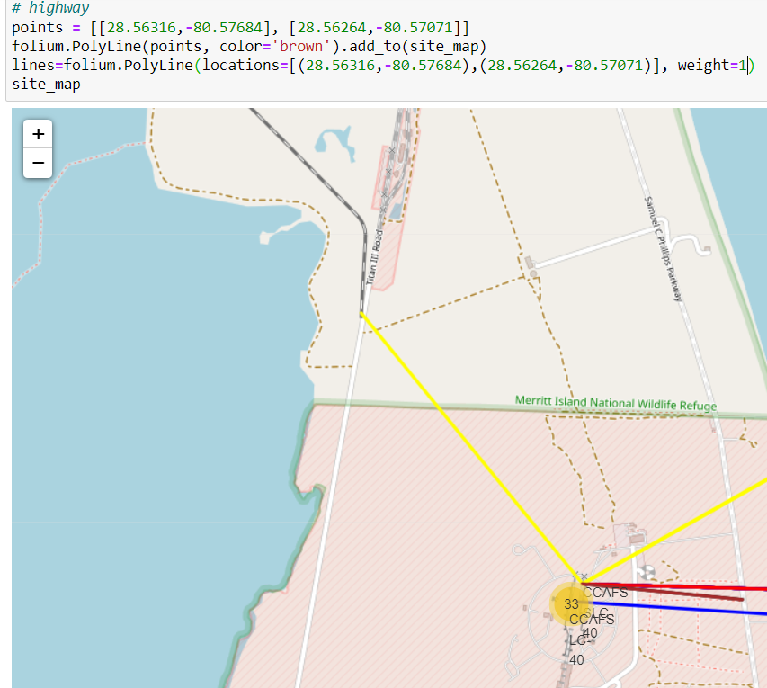
Surrounding Landmarks
It appears that launch sites are usually set up at least 18 km away from cities. This may be because of the desire to prevent any crashes near populated areas.
It is also apparent that launch sites are in very close proximity to railways and highways. Perhaps, due to the necessary transportation requirements for rocket parts.
The sites are close the coast line. This is evident with the many rocket landing tests on water bodies like the ocean.

Slide 37
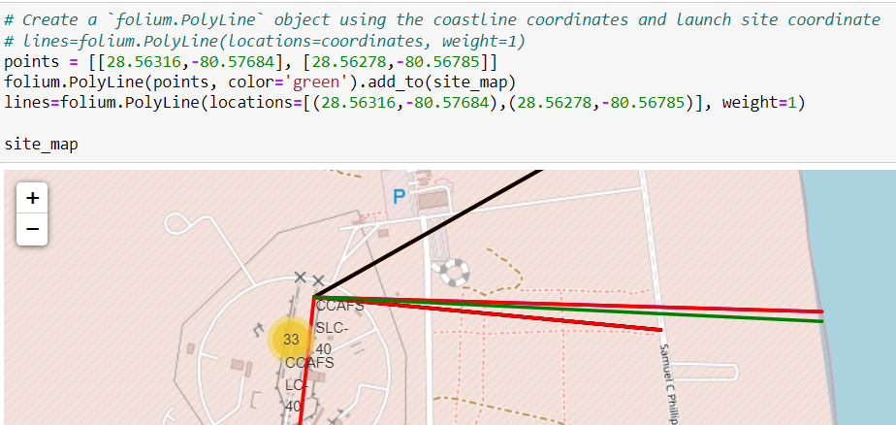
COASTLINE

Slide 38
HIGHWAY

Slide 39
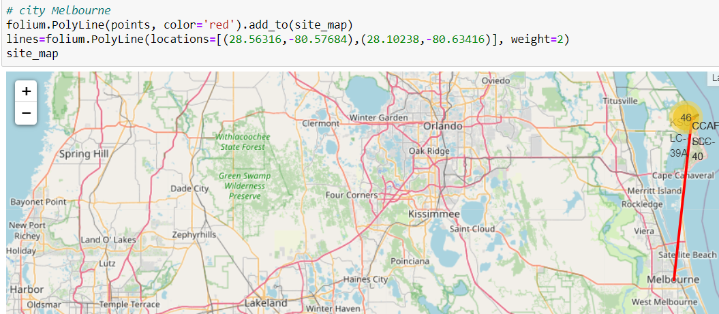
MELBOURNE

Slide 40
SECTION 4
BUILD A DASHBOARD WITH PLOTLY

Slide 41
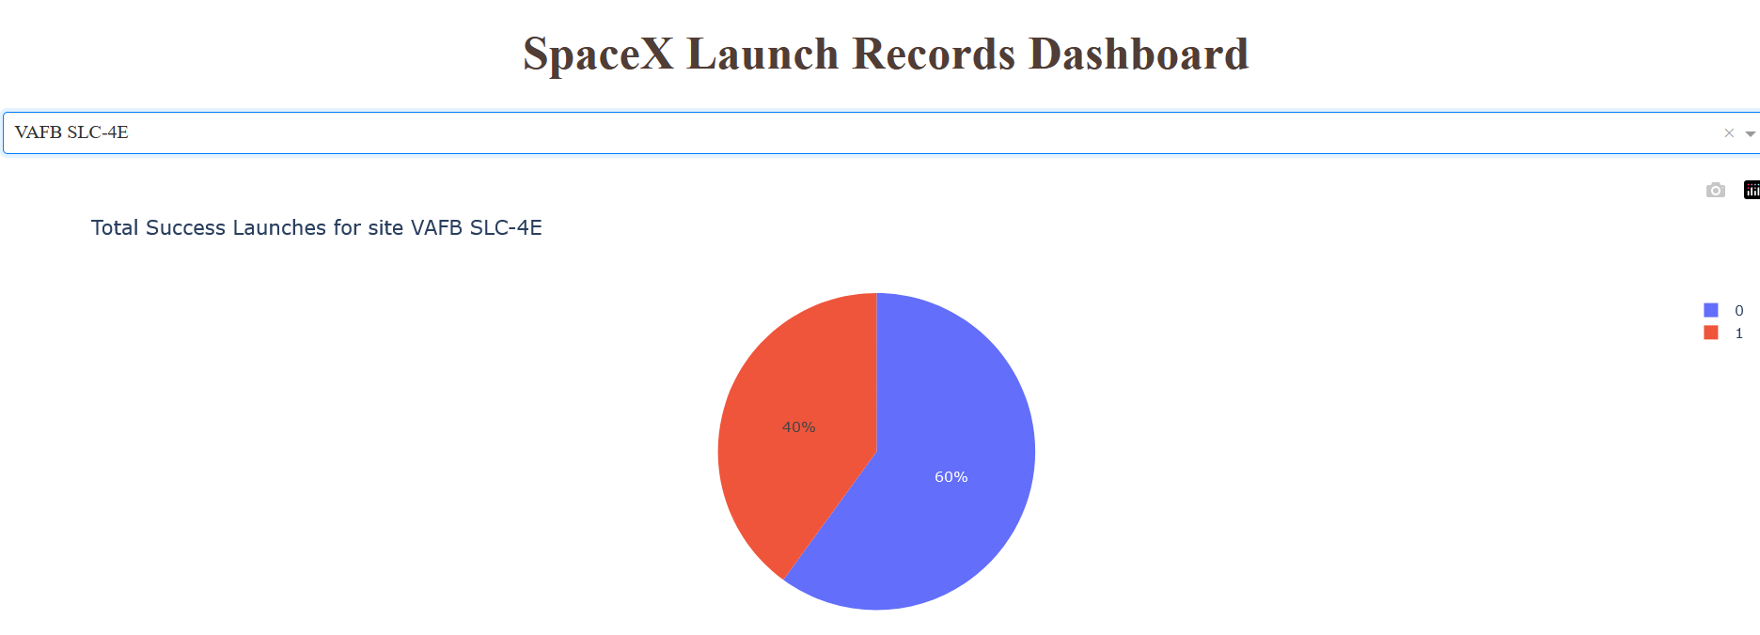
BUILD A DASHBOARD WITH PLOTLY
Successful Launches by Site
You can see from the plot that Site VAFB SLC-4E has only 1successful launch.

Slide 42
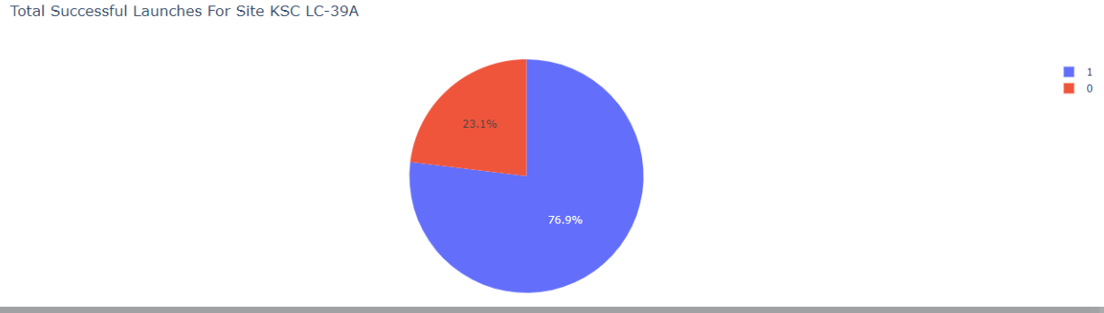
Total Successful Launches for Site KSC LC-39A
You can see that 76.9% of the total launches at site KSC LC-39A were successful. This is a the highest success rate of all the different launch sites.

Slide 43
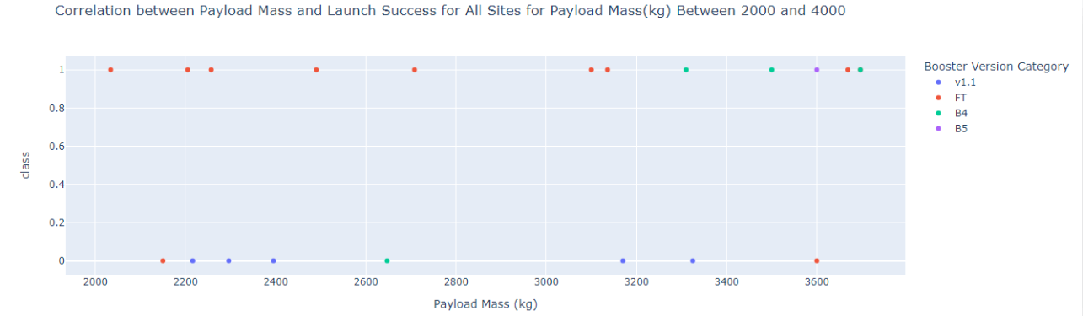
Payload Mass vs. Launch Success for All Sites
It appears that the payload range between 2000 kg and 4000 kg has the highest success rate.

Slide 44
Section 5
PREDICTIVE ANALYSIS(CLASSIFICATION)

Slide 45
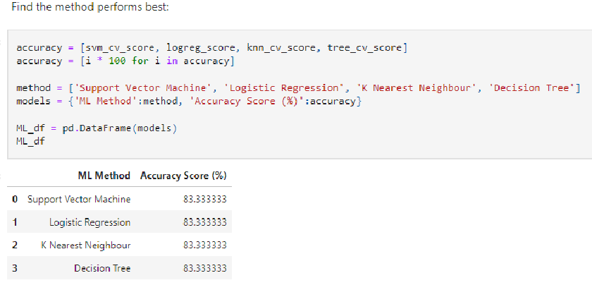
Predictive analysis (classification)
Classification Accuracy
You can see that All the methods have an identical accuracy score of 83.33%, so we decided to use Logistic Regression for the classification.

Slide 46
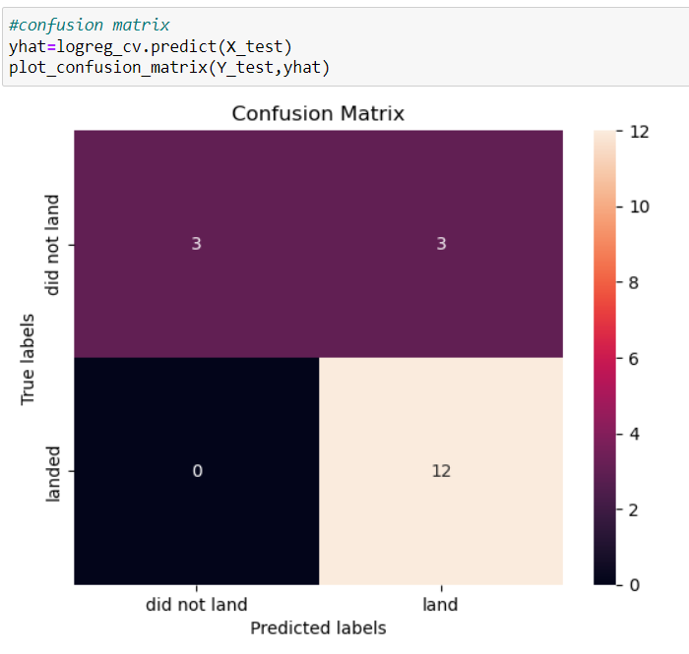
Confusion Matrix
The chart shows the confusion matrix of the Logistic Regression model that was chosen.
The model only failed to accurately predict 3 labels.
GITHUB LINK: https://github.com/mikediego/Mike/blob/62cc4fab04f9b3e8d15eae6e86de15b016000dae/SpaceX_MachineLearning%202022.ipynb

Slide 47
Conclusions
In order to compete with SpaceX Through this process, a general picture of their success methods are: • All their launch sites are located near the coast, away from nearby cities. This enabled to them to test their rocket landings without much interference. • Site KSC LC-39A had the highest launch success rate out of all the launch sites. • From 2015 onwards, the success rate of rocket landings significantly increased. It was also apparent that landing success increased with flight number All this data was used to train a machine learning model that is able to predict the landing outcome of rocket launches with 83.33% accuracy.

Slide 48
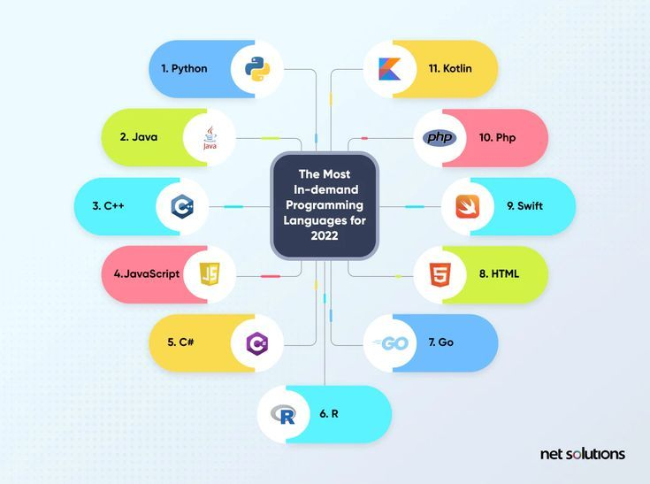


DISCUSSION about new and nowadays trend in programming and databases
What to use?
Where?
When?

Slide 49
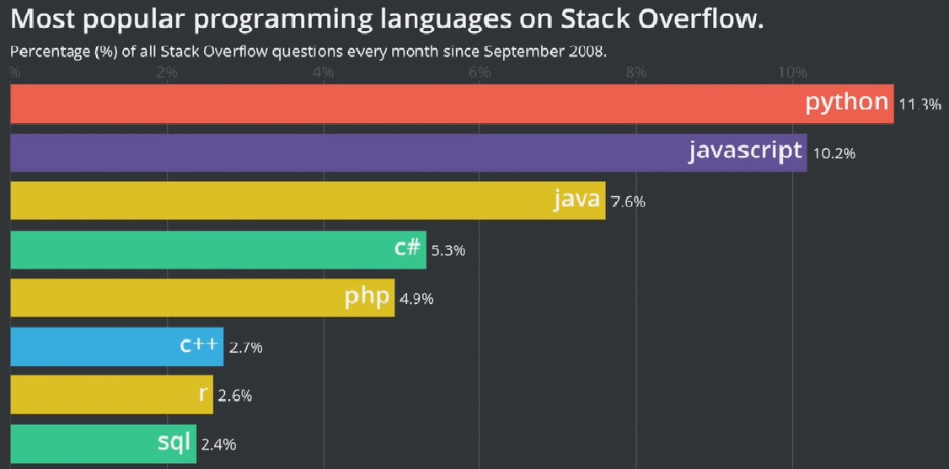
PROGRAMMING LANGUAGE TRENDS
Current Year
Next Year
1.Kotlin
2.TypeScript
3. Swift
4. R
5. Scala
For more information why those languges will play future roll and become more popupar next year clic here: https://www.javaassignmenthelp.com/blog/future-programming-languages/

Slide 50
PROGRAMMING LANGUAGE TRENDS - FINDINGS & IMPLICATIONS
Findings
Finding 1. Languages like Python, Java, R, JavaScript, SQL will still be used.
Finding 2. Those languages are evolving so there is no problem with them being ‘old’.
Finding 3. NOSQL and SQL are popular database languages, but sooner or later we switch towards NOSQL because we don’t need more than 1table, 1file, 1document. It is no relational database so it doesn’t need 4tables to get you one result which saves time, money and storage.
Finding 4. R has a huge usage in AI and next years its gonna be used for machine learning and AI even more.
Implications
Implication 1. Make sure you stay up to date with those language and always learn something new. Python was here 30years and its still evolving so if you stop, in 5years you will need to start study again.
Implication 2. Take a look at new languages because JavaScript will be soon with Java replaced by TypeScreept, and Kotlin. Because its efficiency and language its easier to learn and write.

Slide 51
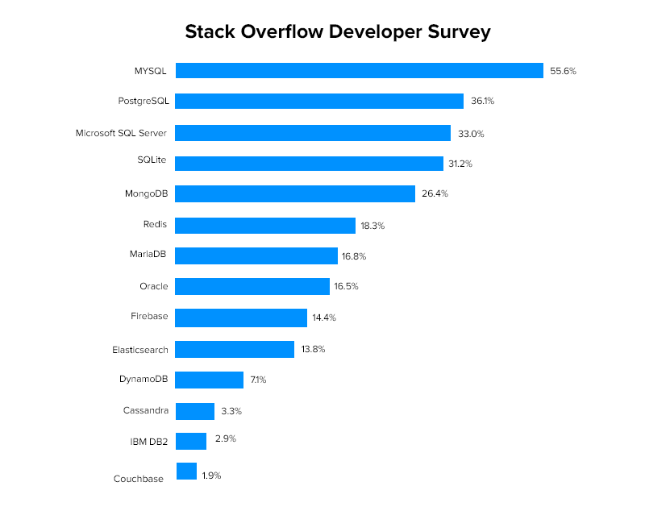
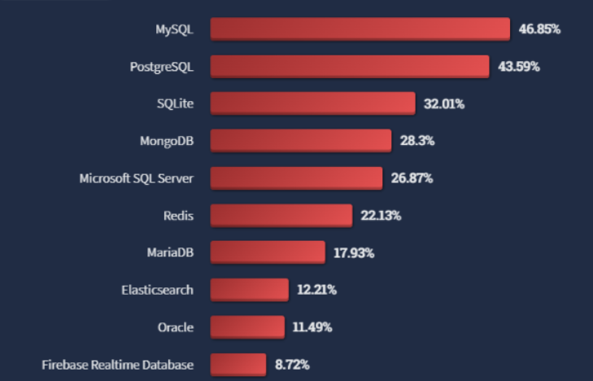
DATABASE TRENDS
Current Year
Next Year

Slide 52
DATABASE TRENDS - FINDINGS & IMPLICATIONS
Findings
Finding 1. Technologies like artificial intelligence, machine learning, data science, and data engineering all rely on some data source somehow. Countless surveys and blogs have data-related jobs at the top with all the emerging technologies today. Since you need SQL to work with databases, learning SQL is definitely among the first steps towards a career that involves data crunching or use in any way.
Finding 2. MySQL is not the best if you want advanced data protection features like throttling and masking. It is also not the best with semi-structured data like JSON. SQL. FACEBOOK, YOUTUBE, UBER use it in their applications. YouTube uses MySQL to store all the metadata for the videos.
PostgreSQL handles semi-structured data such as JSON and has great support for distributed. WHATSUP, TWITCH, NASA, APPLE, SPOTIFY, INSTAGRAM, REDEDIT.
Finding 3 ORACLE - In fact, it is one of the most mature and stable databases today. It is used by major fortune 500 companies around the world for their transactions. Its not free and for 100 employees it can cost 1000s of $. NETFLIX, LINKED IN, EBAY
NoSQL databases (aka "not only SQL") are non-tabular databases and store data differently than relational tables. NoSQL databases come in a variety of types based on their data model. The main types are document, key-value, wide-column, and graph. They provide flexible schemas and scale easily with large amounts of data and high user loads. Storing financial data and healthcare records). Misconception - NoSQL databases like MongoDB do, in fact, support ACID transactions.
MongoDB - Works with semi-structured data such as JSON or XML…
MongoDB is an object-oriented document-based database that stores data inside a collection of documents rather than in rows and columns like in the other databases
Naturally, the lack of pure structure may come at the cost of some ACID transaction inconsistency. If you primarily deal with structured data in your transactions, it is better to use one of the other options.
Microsoft SQL Server – PAIND. BUT CHEAPER THAN ORACLE.
Microsoft’s release of cloud-based Azure SQL database. Azure is a multi-tenant database in which different customers can access a single instance of the database and is a platform-as-a-service (PaaS) offering. Due to the similarities, you can learn SQL Server then switch to Azure as needed. SQL from A to Z in SQL Server is a great track to get you started if you want to start learning SQL for a Microsoft product.
Implications
Implication 1: If you want to work with unstructured data then you can easily go for NoSQL database.
Implication 2: If you will work strictly with Windowns and Miscrosoft products than I recommend to go for Miscrosoft SQL Server. You can work with unstructured data, its paid and you can use SQL on Azure.
Implication 3: Generally you shoud take a closer look at MySQL, ORACLE, PostgreSQL for more wider usage.

Slide 53

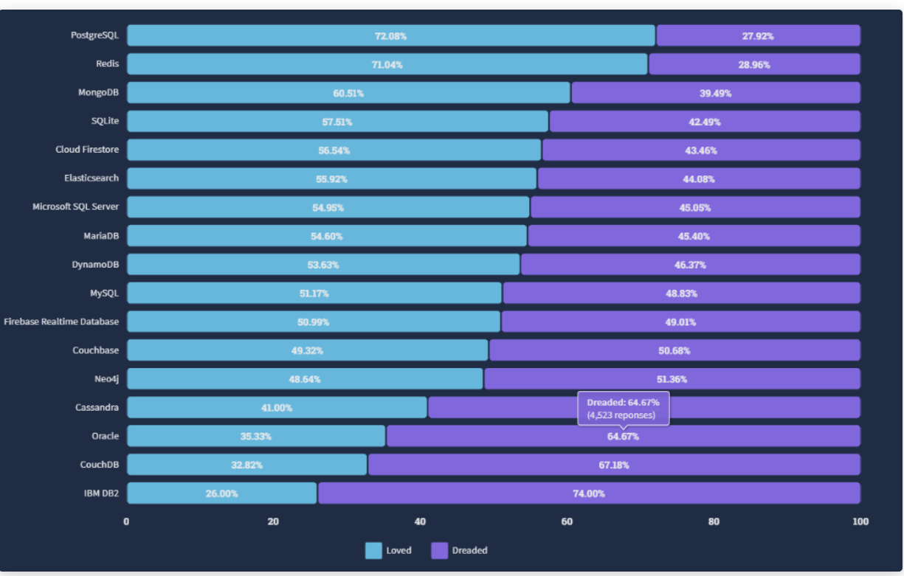
APPENDIX
With nowadays data and questioning developers and users which database systems
they would like to use and that they regret to learn we can see the outcome here:

Slide 54

THANK YOU
CREATED BY: MICHAL UHRINEK

